Slide 1
HANGMAN
The game for learn english
Thành viên nhóm 10:
Trần Thị Hương Phương Thanh
Nguyễn Tấn Lộc
Lý Phát Đạt
Vũ Đạo

Slide 2
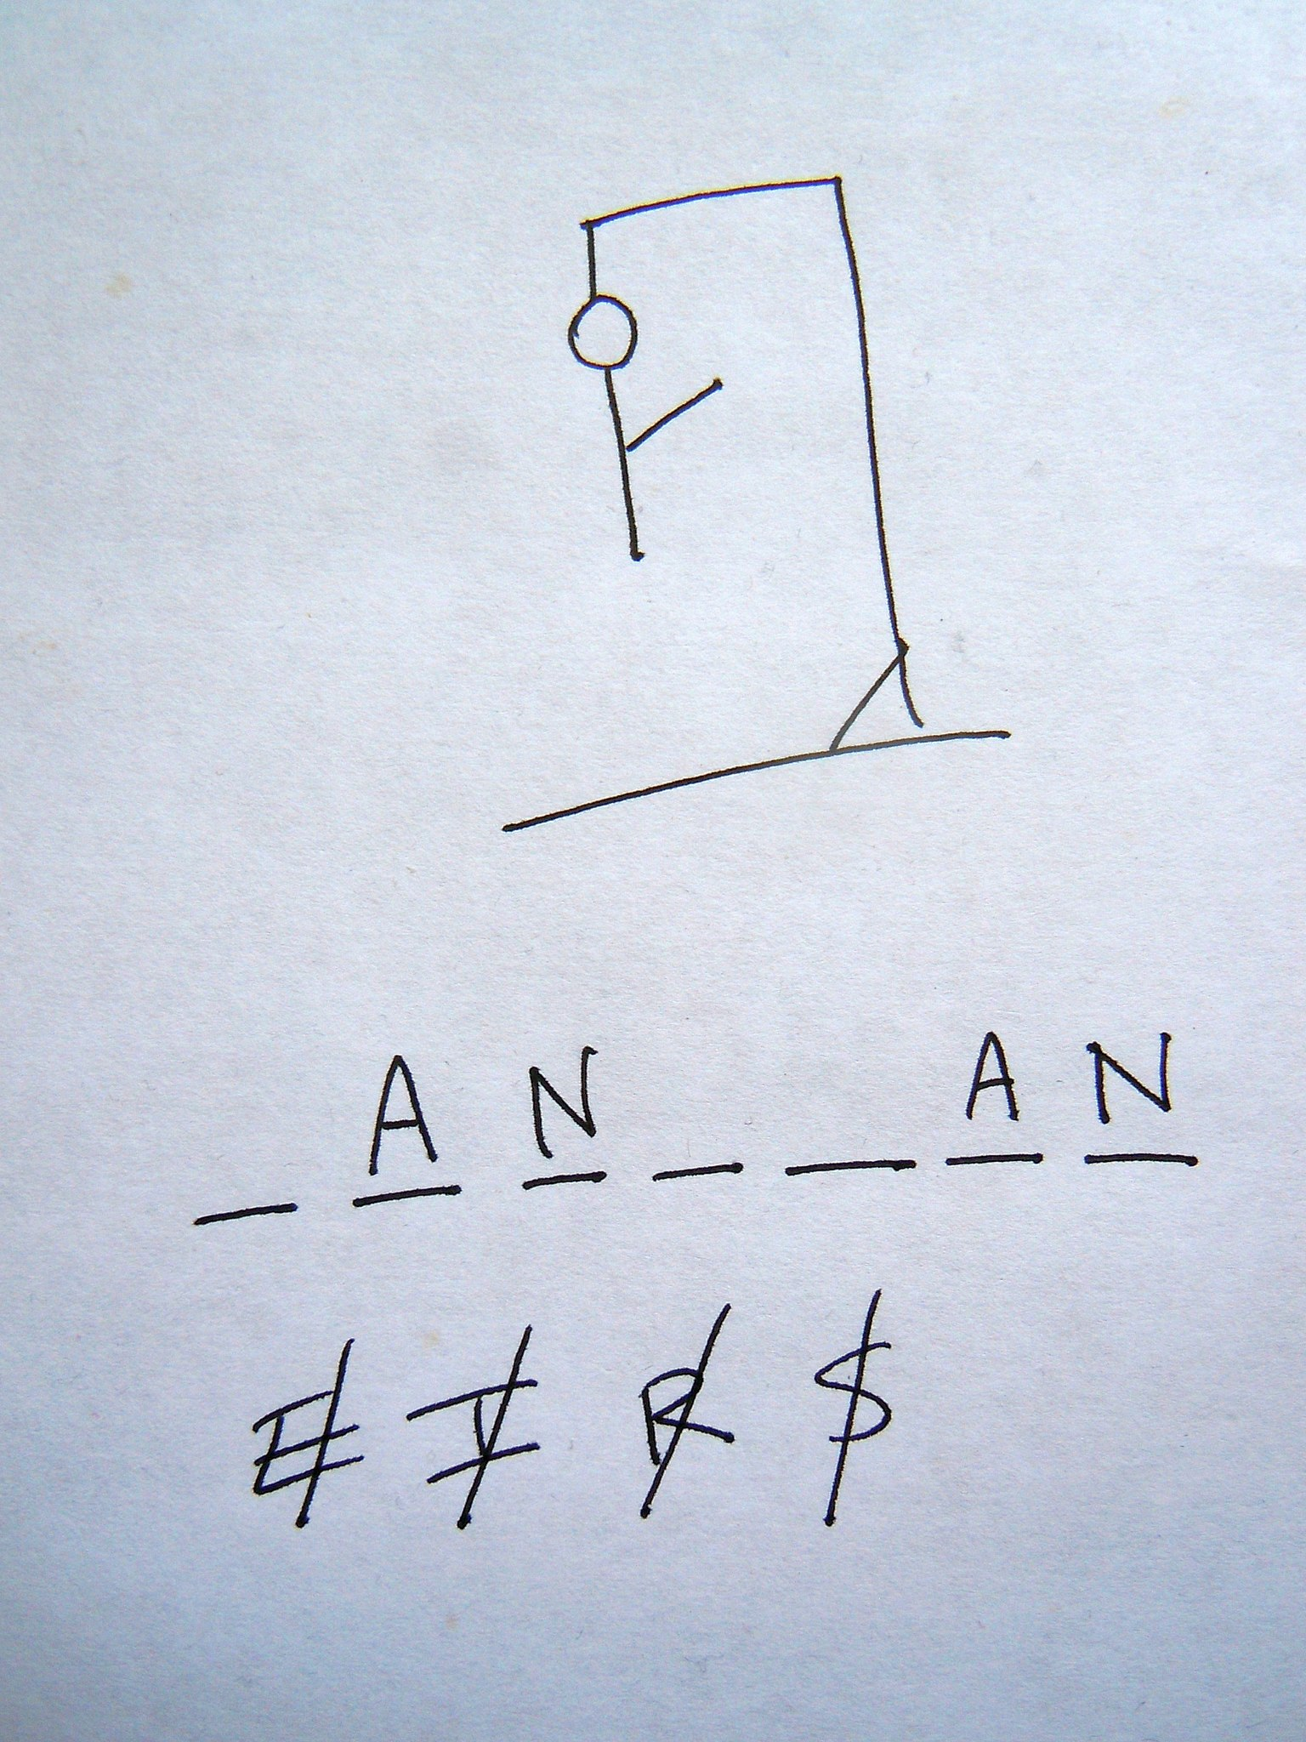

Slide 3
Tổng quan
1. Các thành phần của game
Class RandomWord
Class Word
Class Display
Class Game
Class Start
2. Demo gameplay

Slide 4
1. Các thành phần của game

Slide 5
dictionary.txt
Random_word
Start
Display
Hangman
Word
Game

Slide 6
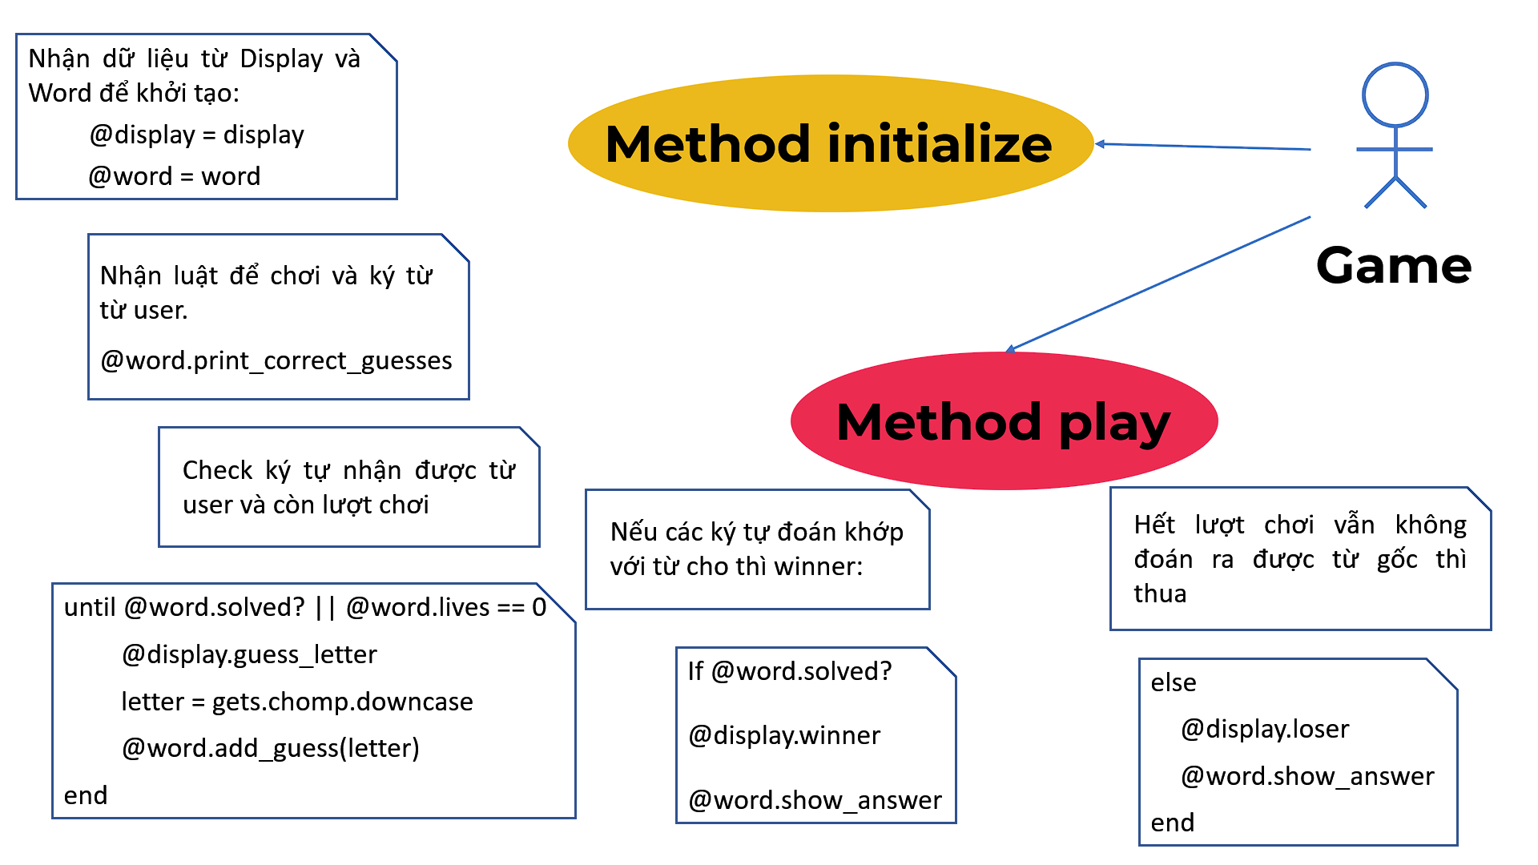
Class Word
class Word
require_relative 'display.rb'
require_relative 'random_word' attr_reader :incorrect_guesses, :correct_guesses, :lives, :display
def initialize(word=RandomWord.new.pick_random_word, lives=8, display=Display.new)
@word = word
@incorrect_guesses = []
@correct_guesses = ["_"] * @word.length
@lives = lives
@display = display
end

Slide 7
Thêm ký tự đúng sai:
So sánh ký tự đoán khớp với các ký tự có trong từ cần đoán:
Methods_add_guess
+ add_correct_guess
+ add_incorrect_guess
add_guess(letter)
2
Hiển thị ký tự đúng sai:
+display_correct_guesses
Methods_display
3
+display_incorrect_guesses
Hiển thị từ cần dự đoán:
1
Word
show_answer
Nhận từ ngẫu nhiên đã chọn
ra từ Random_word
Methods_initialize
@word = word
và số lượt chơi: @lives = 8

Slide 8
Class Display
guess_letter
game_rules
winner
hanged_man
loser

Slide 9
Class Game
initialize
I
display
D
P
W
play
word

Slide 10
Class Start
require 'game'
def play_game
while @play_again == "Y"
new_game = Game.new
new_game.play
self.play_again
@play_again = gets.chomp.upcase
end
self.exit_message
end
initialize
play_game
play_again
exit_message
def initialize(play_again="Y")
@play_again = play_again
end

Slide 11
Class Start
initialize
play_game
play_again
exit_message
def play_game
while @play_again == "Y"
new_game = Game.new
new_game.play
self.play_again
@play_again = gets.chomp.upcase
end.
self.exit_message
end
def initialize(play_again="Y")
@play_again = play_again
end

Slide 12
Class Start
initialize
play_game
play_again
exit_message
def play_game
while @play_again == "Y"
new_game = Game.new
new_game.play
self.play_again
@play_again = gets.chomp.upcase
end.
self.exit_message
end
def play_again
print %Q(
Play again?
>)
end
def initialize(play_again="Y")
@play_again = play_again
end

Slide 13
Class Start
def exit_message
print %Q(
Thanks for playing Hangman!
)
end
initialize
play_game
play_again
exit_message
def play_game
while @play_again == "Y"
new_game = Game.new
new_game.play
self.play_again
@play_again = gets.chomp.upcase
end.
self.exit_message
end
def play_again
print %Q(
Play again?
>)
end
def initialize(play_again="Y")
@play_again = play_again
end

Slide 14
Class Start
initialize
play_game
play_again
exit_message
def exit_message
print %Q(
Thanks for playing Hangman!
)
end
def initialize(play_again="Y")
@play_again = play_again
end

Slide 15
DEMO
DEMO
DEMO

Slide 16
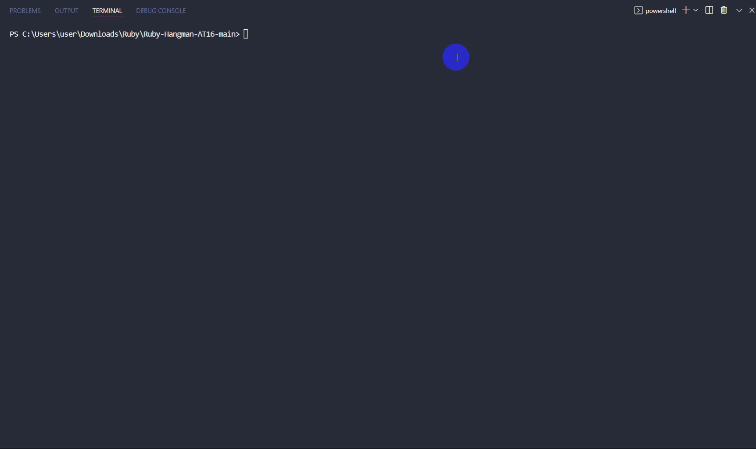
Demo Gameplay

Slide 17
Demo Gameplay
https://github.com/phuongThanhKMA/Ruby-Hangman-AT16

Slide 18
Thank you!

